Slide 1



The Popularity Rise Of Kokomi
A Portofolio Project by
Reynaldi Evans Adam

Slide 2


Introduction
Once considered one of the most divisive characters in the community due to her niche mechanics, Kokomi's reputation has undergone a transformation. Over time, players have begun to embrace her, particularly for her role in Spiral Abyss gameplay and team composition.
In this presentation, I will delve into the analysis of Kokomi's evolving popularity, examining the factors contributing to her rise in popularity as the game unfolds

Slide 3

Data Overview
I have gathered Genshin Impact banner data from Kaggle , collected spiral abyss characters ranked data while created a survey and received responses from 77 participants within the Indonesian Genshin community. Based on this collected data, I will present an analysis of the evolving popularity of Kokomi in Genshin Impact.

Slide 4
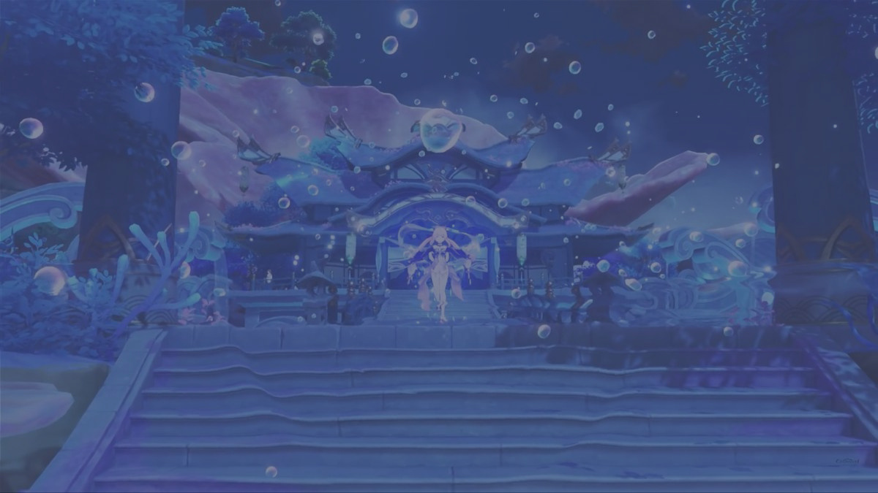
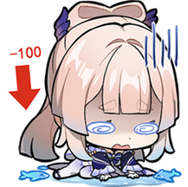
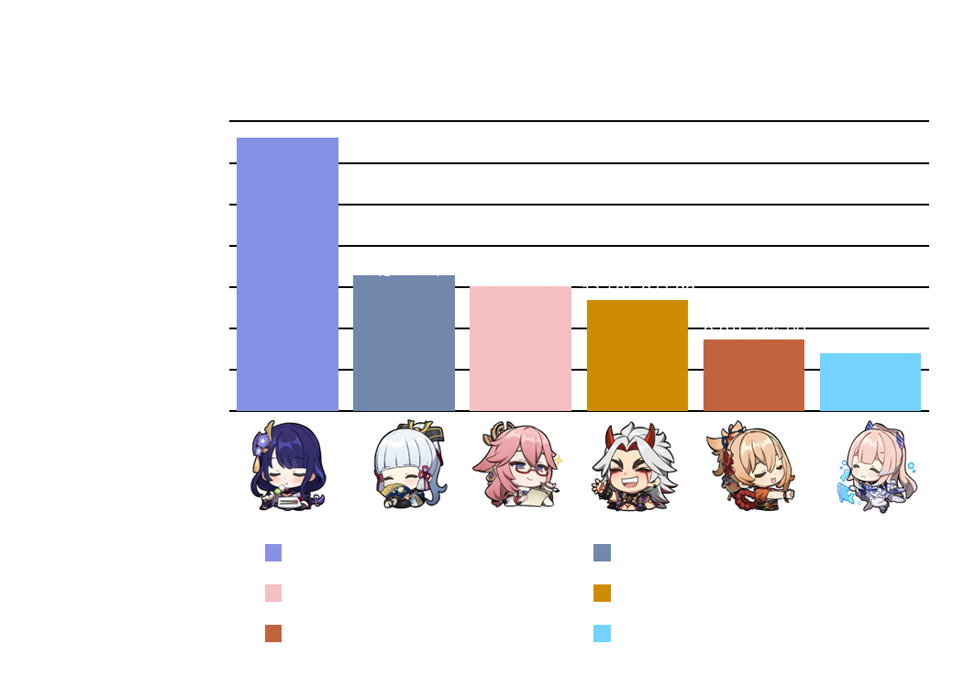
How Unpopular Was Kokomi?
Based on a Kaggle dataset analyzing Genshin's Character Banner Revenue, Kokomi exhibited the lowest initial Solo Banner Revenue among Inazuma characters upon her debut in the iOS China market, in contrast to other solo banners from the same region.

Slide 5

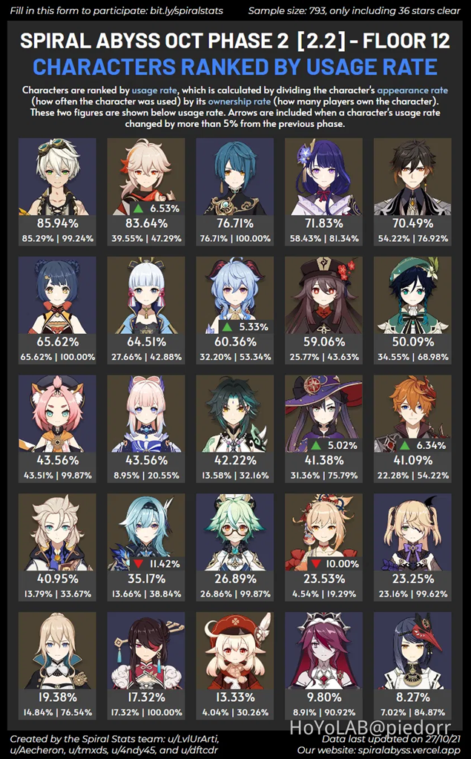
How Unpopular Was Kokomi?
Within Spiral Abyss version 2.2, Kokomi exhibits notably lower figures, with an appearance rate of 8.95% and an ownership rate of 20.55%.

Slide 6

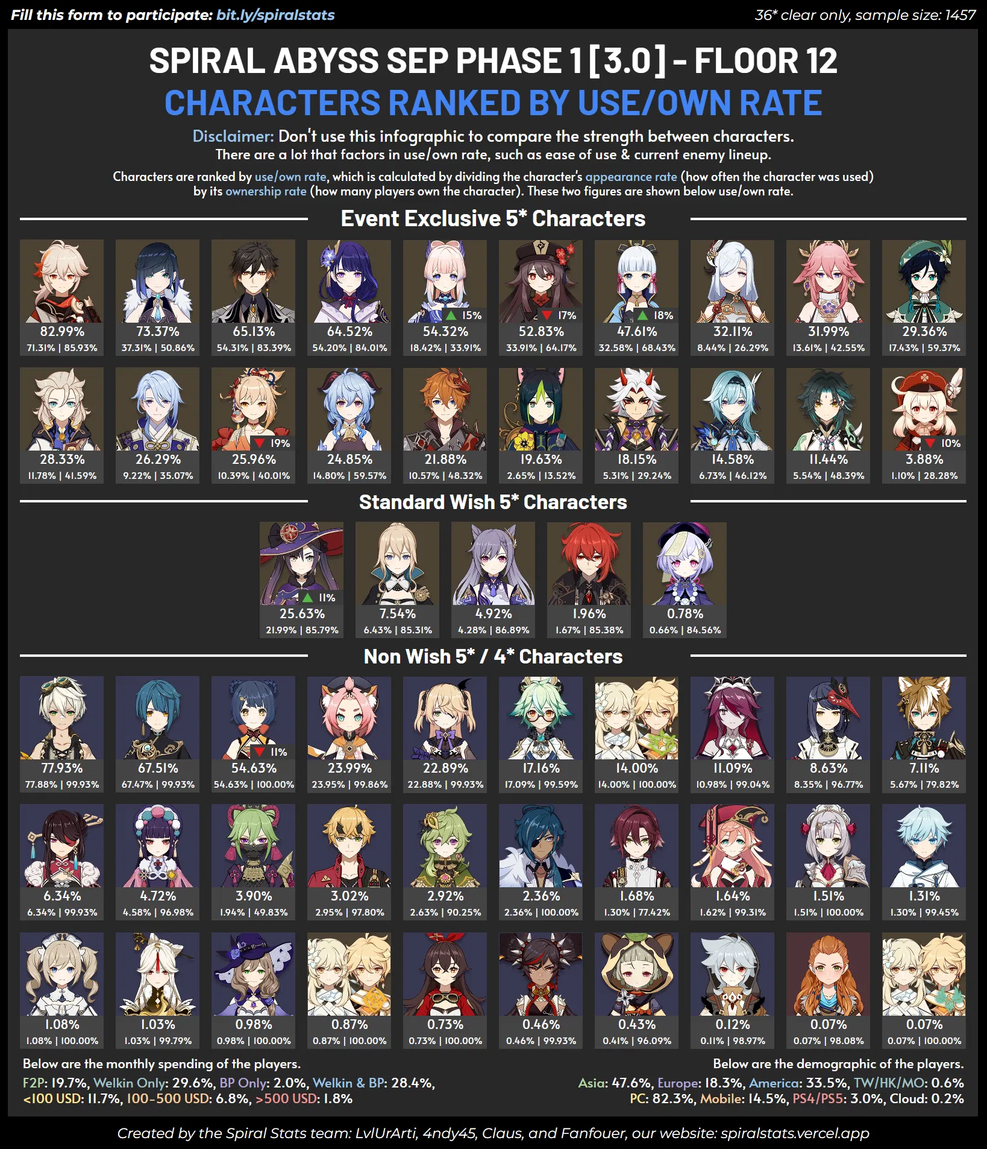
And people started to like kokomi!
In version 3.0, Kokomi undergoes a remarkable transformation, marked by a substantial rise in appearance rate (18.42%) and ownership rate (33.91%).

Slide 7

Questionnaire Results (Respondents Segmentations)
40
30
This bar chart vividly illustrates the disparities among respondents based on the version of Genshin Impact they embarked on their immersive journey.
20
10
0
Version 1.0 - 1.6
Version 2.0 - 2.8
Version 3.0 Keatas

Slide 8
Questionnaire Results (Respondents Segmentations)
AR 30 – 35 (World Level 3)
1.3%
AR 40 – 45 (World Level 5)
6.5%
This pie chart shows the difference of respondents' current AR/level of their account
AR 55 – 60 (World Level 8)
87%

Slide 9
Questionnaire Results
Have Kokomi
29.9%
This pie chart shows the difference in percentages of respondents who currently have and don't have kokomi in their accounts
No Kokomi
70.1%

Slide 10
Questionnaire Results
Second Rerun (Ver 3.0)
17.4%
Among the 23 respondents who possess Kokomi in their accounts, a significant portion of these players opted to pull for her from her initial release onwards.
First Release (Ver 2.1)
43.5%
First Rerun (Ver. 2.5)
39.1%

Slide 11
Questionnaire Results: Reasons you pulled for Kokomi
Well-suited for specific party compositions
14.9%
Engaging character design
23%
Beneficial gameplay mechanics changes/additions
62.1%
The pie chart vividly illustrates the reasons players pulled for Kokomi. It showcases the main motivations, offering a clear visual representation of player preferences and contributing factors.

Slide 12
Questionnaire Results: Reasons you don't have Kokomi
Lack Of Primogems
6%
Haven't played Genshin in her Banner
10%
Lost A Rate Off
14%
Prefer Other characters
70%
From the respondents who don't have Kokomi, the majority of the respondents answered that they prefer other characters to pull

Slide 13
Questionnaire Results: If Kokomi holds a banner rerun, would you be interested in pulling for Kokomi?
No
14.8%
But based on the survey participants, a significant portion of those who currently do not have Kokomi expressed their interest in pulling for her in her next rerun.
Yes
85.2%

Slide 14

Hypothesis: Before the release of corrosion and the Dendro element, Kokomi could be substituted by other healers (Bennett, Barbara, etc.) in a party composition.
30
The majority of respondents indicated that the hypothesis is subject to debate, but most respondents tend to agree with the hypothesis that people preferred other healers over Kokomi before the introduction of corrosion mechanics and dendro elements.
20
10
0
Heavily Disagree
Disagree
Debatable
Agree
Heavily Agree

Slide 15

Hypothesis: After the release of the corrosion effect, Kokomi is seen to be more needed as a healer.
40
When considering the opinions of our respondents, a clear trend emerges. The majority of participants show agreement with the hypothesis after the corrosion mechanics were introduced. This suggests that the gameplay change indeed influenced how players perceive Kokomi's role, aligning with our initial hypothesis.
30
20
10
0
Heavily Disagree
Disagree
Debatable
Agree
Heavily Agree

Slide 16

Hypothesis: After the release of the Dendro element, Kokomi is seen to be more needed in Dendro reaction compositions as a healer (Bloom/Hyperbloom/Burgeon).
60
The hypothesis received overwhelming support from the majority of respondents, with no participants indicating strong disagreement. Additionally, a significant number of respondents agree that Kokomi is a favorable choice for a Dendro party composition.
40
20
0
Heavily Disagree
Disagree
Debatable
Agree
Heavily Agree

Slide 17
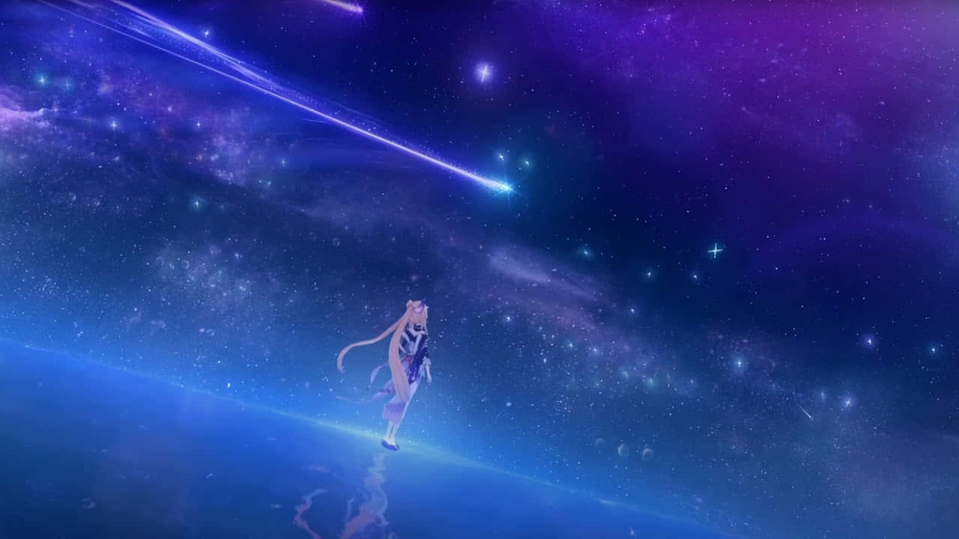

Summary
Kokomi's Rising Popularity: Through data analysis, we found that Kokomi's popularity has significantly increased over time, challenging initial perceptions.
Corrosion Effect Impact: The introduction of the corrosion effect led to a notable shift in Kokomi's role, making her a more crucial healer in player strategies.
Dendro Synergy: Following the release of the dendro element, Kokomi became a valuable healer in dendro party compositions, reflecting a shift in player preferences.

